Slide 1
Supercar company
Character of business team

Slide 2
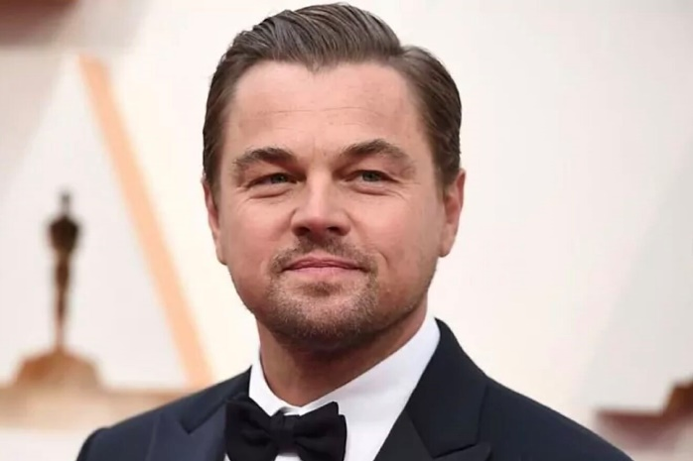
General director
Negotiation character - The tactics of delaying
That person prefer listening instead of saying, he thinks that his product should say about his success, that’s main reason why he chose that character of negotiations. Also, when you are listening you may know more

Slide 3

Financial director
Negotiation character - The tactics of false rejection
Her main goal is save money and she does not care how to achieve the goal, sometimes she reject the offer for getting better proposal.
Also, when you are reject an offer – you may know something interesting about service, may receive additional service and so on

Slide 4
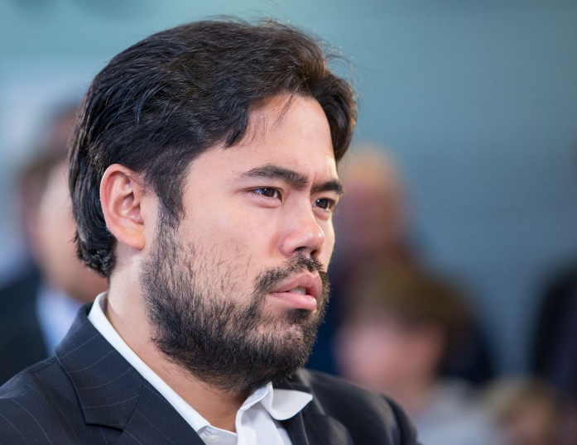
Engineer
Negotiation character - The tactics of fait accompli
That person prefer facts as arguments, he actually say about product and nothing else

Slide 5
Supermarketing company
Character of business team

Slide 6
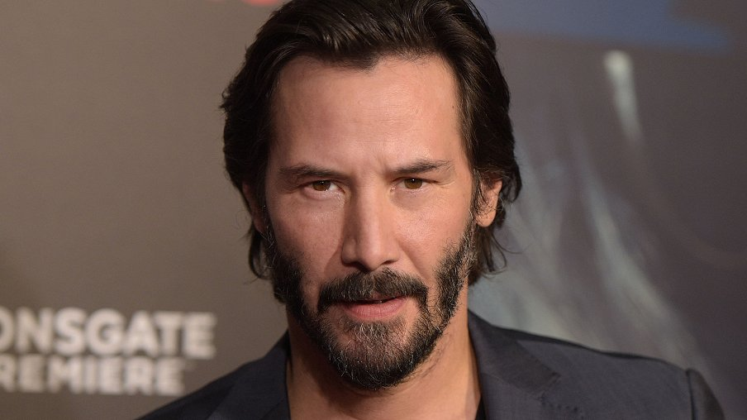
General director
Negotiation character - The tactics of "salami“
He wants to sell as much as possible count of services, he propose one main service and add additional services and explain their addvanatges

Slide 7

Financial director
Negotiation character - The tactics of fait accompli
Because she works at marketing company, she has already know some manipulation features, that main reason, why she said ‘you bought‘ instead of ‘that service cost’
She is a manipulator

Slide 8
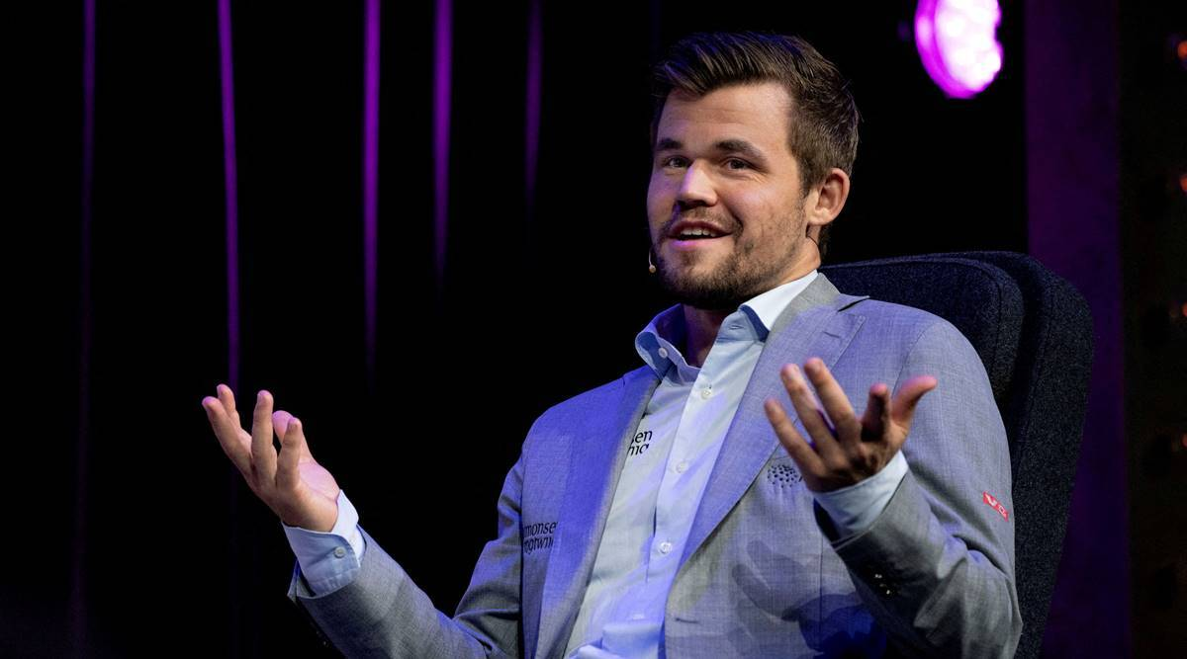
Ads creator
Negotiation character - The tactics of surprise
His main goal is create ads, so that main reason, why he is so spontaneous and it helps him to create an ads

